Slide 1
Unit 3
Resampling

Slide 2
We discuss the following in today’s Lecture
What is Resampling?
Some Common Resampling Techniques/Methods
Cross-validation and The Bootstrap
Test error versus Training error

Slide 3
What is Resampling?
Resampling is a computationally intensive statistical technique in which multiple new samples are drawn (generated) from the data sample or from the population inferred by the data sample.
Certain statistics (or estimates) of interest (e.g., the sample mean) are then calculated for each of these new samples, and the resulting multiple calculated values of the statistics are then analyzed in order to investigate and estimate various properties (e.g., the sampling distribution, the error, the bias) of the statistics.

Slide 4
Resampling
Resampling methods are a key tool in modern statistics and machine learning.
Resampling methods involve:
1. Repeatedly drawing a sample from the training data.
2. Refitting the model of interest with each new sample.
3. Examining all of the refitted models and then obtain additional information about that fitted model.

Slide 5
Resampling cont…
Resampling is computationally very expensive but with the advent of modern computing this is not a major drawback.
There are two major resampling techniques
Cross-Validation: It is generally used to estimate test error or to select the appropriate level of flexibility.
The Bootstrap: It is used in several contexts, most commonly to provide a measure of accuracy of a parameter estimate or of a given statistical learning

Slide 6
Cross-validation and the bootstrap are easy to implement and very broadly applicable.
Model assessment: The process of evaluating a model’s performance.
Model selection: The process of selecting the proper level of flexibility for a model.

Slide 7
Test error versus Training error
The test error is the average error that results from using a statistical learning method to predict the response on a new observation, one that was not used in training the method.
The training error is the average error that results from using a statistical learning method to predict the response on the data that was used to train the method.
But the training error rate often is quite
different from the test error rate, and in particular the former can dramatically underestimate the later.

Slide 8
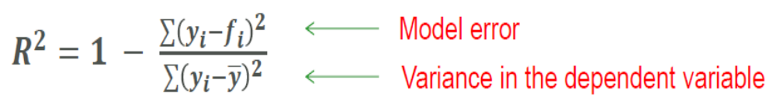
How to check if a model fit is good?
The R² statistic has become the almost universally standard measure for model fit in linear models.
What is R²?
It is the ratio of error in a model over the total variance in the dependent variable.
Hence the lower the error, the higher the R² value.

Slide 9
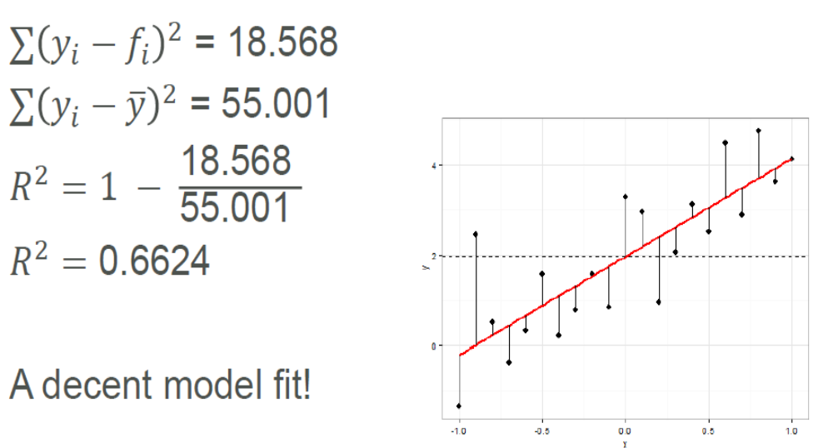
How to check if a model fit is good?

Slide 10
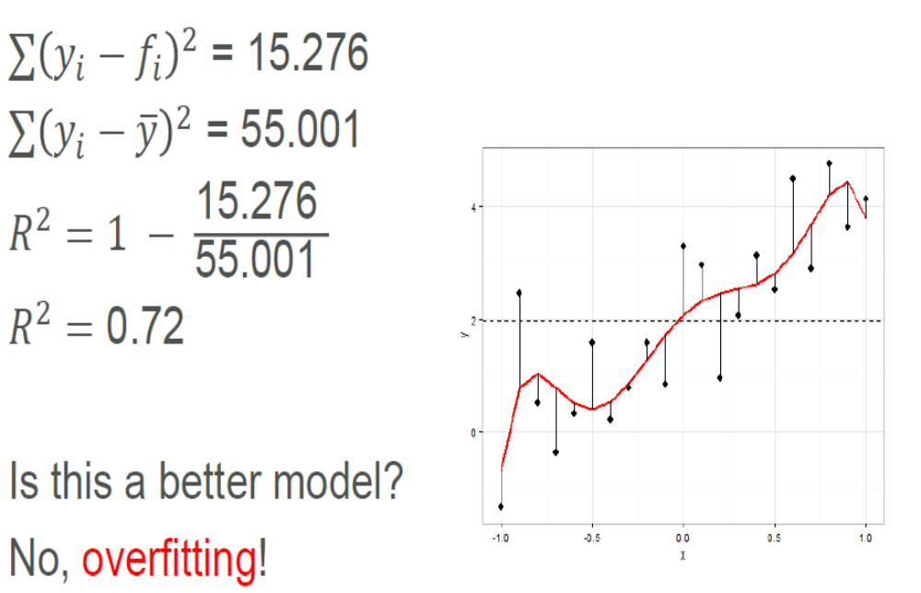
How to check if a model fit is good?

Slide 11
A Regression Problem
y = f(x) + noise
Can we learn f from this data?
Let’s consider three methods…
y
x

Slide 12
Linear Regression
y
x

Slide 13
Quadratic Regression
y
x

Slide 14
Join-the-dots
Also known as piecewise linear nonparametric regression if that makes you feel better
y
x

Slide 15
Which is best?
y
y
x
x
Why not choose the method with the best fit to the data?

Slide 16
What do we really want?
y
y
x
x
Why not choose the method with the best fit to the data?
“How well are you going to predict future data drawn from the same distribution?”

Slide 17
The test set method
1. Randomly choose 30% of the data to be in a test set
2. The remainder is a training set
y
x

Slide 18
The test set method
1. Randomly choose 30% of the data to be in a test set
2. The remainder is a training set
3. Perform your regression on the training set
y
x
(Linear regression example)

Slide 19
The test set method
1. Randomly choose 30% of the data to be in a test set
2. The remainder is a training set
3. Perform your regression on the training set
4. Estimate your future performance with the test set
y
x
(Linear regression example)
Mean Squared Error = 2.4

Slide 20
The test set method
1. Randomly choose 30% of the data to be in a test set
2. The remainder is a training set
3. Perform your regression on the training set
4. Estimate your future performance with the test set
y
x
(Quadratic regression example)
Mean Squared Error = 0.9

Slide 21
The test set method
1. Randomly choose 30% of the data to be in a test set
2. The remainder is a training set
3. Perform your regression on the training set
4. Estimate your future performance with the test set
y
x
(Join the dots example)
Mean Squared Error = 2.2

Slide 22
The test set method
Pros:
Very very simple
Can then simply choose the method with the best test-set score
Cons:
What’s the downside?

Slide 23
The test set method
Pros:
Very very simple
Can then simply choose the method with the best test-set score
Cons:
Wastes data: we get an estimate of the best method to apply to 30% less data
If we don’t have much data, our test-set might just be lucky or unlucky
We say the “test-set estimator of performance has high variance”

Slide 24
LOOCV (Leave-one-out Cross Validation)
For k=1 to R
  1. Let (x_{k},y_{k}) be the k^{th} record
y
x

Slide 25
LOOCV (Leave-one-out Cross Validation)
For k=1 to R
  1. Let (x_{k},y_{k}) be the k^{th} record
  2. Temporarily remove (x_{k},y_{k}) from the dataset
y
x

Slide 26
LOOCV (Leave-one-out Cross Validation)
For k=1 to R
  1. Let (x_{k},y_{k}) be the k^{th} record
  2. Temporarily remove (x_{k},y_{k}) from the dataset
  3. Train on the remaining R-1 datapoints
y
x

Slide 27
LOOCV (Leave-one-out Cross Validation)
For k=1 to R
  1. Let (x_{k},y_{k}) be the k^{th} record
  2. Temporarily remove (x_{k},y_{k}) from the dataset
  3. Train on the remaining R-1 datapoints
  4. Note your error (x_{k},y_{k})
y
x

Slide 28
LOOCV (Leave-one-out Cross Validation)
For k=1 to R
  1. Let (x_{k},y_{k}) be the k^{th} record
  2. Temporarily remove (x_{k},y_{k}) from the dataset
  3. Train on the remaining R-1 datapoints
  4. Note your error (x_{k},y_{k})
When you’ve done all points, report the mean error.
y
x

Slide 29
LOOCV (Leave-one-out Cross Validation)
For k=1 to R
  1. Let (x_{k},y_{k}) be the k^{th} record
  2. Temporarily remove (x_{k},y_{k}) from the dataset
  3. Train on the remaining R-1 datapoints
  4. Note your error (x_{k},y_{k})
When you’ve done all points, report the mean error.
y
y
y
x
x
x
y
y
y
x
x
x
MSE_{LOOCV} = 2.12
y
y
y
x
x
x

Slide 30
LOOCV for Quadratic Regression
For k=1 to R
  1. Let (x_{k},y_{k}) be the k^{th} record
  2. Temporarily remove (x_{k},y_{k}) from the dataset
  3. Train on the remaining R-1 datapoints
  4. Note your error (x_{k},y_{k})
When you’ve done all points, report the mean error.
y
y
y
x
x
x
y
y
y
x
x
x
MSE_{LOOCV}=0.962
y
y
y
x
x
x

Slide 31
LOOCV for Join The Dots
For k=1 to R
  1. Let (x_{k},y_{k}) be the k^{th} record
  2. Temporarily remove (x_{k},y_{k}) from the dataset
  3. Train on the remaining R-1 datapoints
  4. Note your error (x_{k},y_{k})
When you’ve done all points, report the mean error.
y
y
y
x
x
x
y
y
y
x
x
x
MSE_{LOOCV}=3.33
y
y
y
x
x
x

Slide 32
Which kind of Cross Validation?
 | Downside | Upside
Test-set | Variance: unreliable estimate of future performance | Cheap
Leave-one-out | Expensive. Has some weird behavior | Doesn’t waste data
..can we get the best of both worlds?

Slide 33
k-fold Cross Validation
Randomly break the dataset into k partitions (in our example we’ll have k=3 partitions colored Red Green and Blue)
y
x

Slide 34
k-fold Cross Validation
Randomly break the dataset into k partitions (in our example we’ll have k=3 partitions colored Red Green and Blue)
  For the red partition: Train on all the points not in the red partition. Find the test-set sum of errors on the red points.
y
x

Slide 35
k-fold Cross Validation
Randomly break the dataset into k partitions (in our example we’ll have k=3 partitions colored Red Green and Blue)
  For the red partition: Train on all the points not in the red partition. Find the test-set sum of errors on the red points.
  For the green partition: Train on all the points not in the green partition. Find the test-set sum of errors on the green points.
y
x

Slide 36
k-fold Cross Validation
Randomly break the dataset into k partitions (in our example we’ll have k=3 partitions colored Red Green and Blue)
  For the red partition: Train on all the points not in the red partition. Find the test-set sum of errors on the red points.
  For the green partition: Train on all the points not in the green partition. Find the test-set sum of errors on the green points.
  For the blue partition: Train on all the points not in the blue partition. Find the test-set sum of errors on the blue points.
y
x

Slide 37
k-fold Cross Validation
Randomly break the dataset into k partitions (in our example we’ll have k=3 partitions colored Red Green and Blue)
  For the red partition: Train on all the points not in the red partition. Find the test-set sum of errors on the red points.
  For the green partition: Train on all the points not in the green partition. Find the test-set sum of errors on the green points.
  For the blue partition: Train on all the points not in the blue partition. Find the test-set sum of errors on the blue points.
  Then report the mean error
y
x
Linear Regression MSE_{3FOLD}=2.05

Slide 38
k-fold Cross Validation
Randomly break the dataset into k partitions (in our example we’ll have k=3 partitions colored Red Green and Blue)
  For the red partition: Train on all the points not in the red partition. Find the test-set sum of errors on the red points.
  For the green partition: Train on all the points not in the green partition. Find the test-set sum of errors on the green points.
  For the blue partition: Train on all the points not in the blue partition. Find the test-set sum of errors on the blue points.
  Then report the mean error
y
x
Quadratic Regression MSE_{3FOLD}=1.11

Slide 39
k-fold Cross Validation
Randomly break the dataset into k partitions (in our example we’ll have k=3 partitions colored Red Green and Blue)
  For the red partition: Train on all the points not in the red partition. Find the test-set sum of errors on the red points.
  For the green partition: Train on all the points not in the green partition. Find the test-set sum of errors on the green points.
  For the blue partition: Train on all the points not in the blue partition. Find the test-set sum of errors on the blue points.
  Then report the mean error
y
x
Joint-the-dots MSE_{3FOLD}=2.93

Slide 40
Which kind of Cross Validation?
 | Downside | Upside
Test-set | Variance: unreliable estimate of future performance | Cheap
Leave-one-out | Expensive. Has some weird behavior | Doesn’t waste data
10-fold | Wastes 10% of the data. 10 times more expensive than test set | Only wastes 10%. Only 10 times more expensive instead of R times.
3-fold | Wastier than 10-fold. Expensivier than test set | Slightly better than test-set
R-fold | Identical to Leave-one-out

Slide 41
Which kind of Cross Validation?
 | Downside | Upside
Test-set | Variance: unreliable estimate of future performance | Cheap
Leave-one-out | Expensive. Has some weird behavior | Doesn’t waste data
10-fold | Wastes 10% of the data. 10 times more expensive than testset | Only wastes 10%. Only 10 times more expensive instead of R times.
3-fold | Wastier than 10-fold. Expensivier than testset | Slightly better than test-set
R-fold | Identical to Leave-one-out
But note: One of Andrew’s joys in life is algorithmic tricks for making these cheap

Slide 42
CV-based Model Selection
We’re trying to decide which algorithm to use.
We train each machine and make a table…
Here f_{i} are algorithms
i | f_{i} | TRAINERR | 10-FOLD-CV-ERR | Choice
1 | f₁
2 | f₂
3 | f₃ |  |  | 
4 | f₄
5 | f₅
6 | f₆

Slide 43
CV-based Model Selection
Example: Choosing number of hidden units in a one-hidden-layer neural net.
Step 1: Compute 10-fold CV error for six different model classes:
Algorithm | TRAINERR | 10-FOLD-CV-ERR | Choice
0 hidden units
1 hidden units
2 hidden units |  |  | 
3 hidden units
4 hidden units
5 hidden units
Step 2: Whichever model class gave best CV score: train it with all the data, and that’s the predictive model you’ll use.

Slide 44
CV-based Model Selection
Example: Choosing “k” for a k-nearest-neighbor regression.
Step 1: Compute LOOCV error for six different model classes:
Algorithm | TRAINERR | 10-fold-CV-ERR | Choice
K=1
K=2
K=3
K=4 |  |  | 
K=5
K=6
Step 2: Whichever model class gave best CV score: train it with all the data, and that’s the predictive model you’ll use.

Slide 45
CV-based Model Selection
Example: Choosing “k” for a k-nearest-neighbor regression.
Step 1: Compute LOOCV error for six different model classes:
Algorithm | TRAINERR | LOOCV-ERR | Choice
K=1
K=2
K=3
K=4 |  |  | 
K=5
K=6
Step 2: Whichever model class gave best CV score: train it with all the data, and that’s the predictive model you’ll use.

Slide 46
CV-based Model Selection
Can you think of other decisions we can ask Cross Validation to make for us, based on other machine learning algorithms in the class so far?

Slide 47
CV-based Model Selection
Can you think of other decisions we can ask Cross Validation to make for us, based on other machine learning algorithms?
  Degree of polynomial in polynomial regression
  Whether to use full, diagonal or spherical Gaussians in a Gaussian Bayes Classifier.
  The Kernel Width in Kernel Regression
  The Kernel Width in Locally Weighted Regression
  The Bayesian Prior in Bayesian Regression
These involve choosing the value of a real-valued parameter. What should we do?

Slide 48
CV-based Algorithm Choice
Example: Choosing which regression algorithm to use
Step 1: Compute 10-fold-CV error for six different model classes:
Algorithm | TRAINERR | 10-fold-CV-ERR | Choice
1-NN
10-NN
Linear Reg’n
Quad reg’n |  |  | 
LWR, KW=0.1
LWR, KW=0.5
Step 2: Whichever algorithm gave best CV score: train it with all the data, and that’s the predictive model you’ll use.

Slide 49
Supervising Gradient Descent
This is a weird but common use of Test-set validation
Suppose you have a neural net with too many hidden units. It will overfit.
As gradient descent progresses, maintain a graph of MSE-testset-error vs. Iteration
Training Set
Test Set
Use the weights you found on this iteration
Mean Squared Error
Iteration of Gradient Descent

Slide 50
Cross-Validation for regression
Choosing the number of hidden units in a neural net
Feature selection (see later)
Choosing a polynomial degree
Choosing which regressor to use

Slide 51
Cross-validation for classification
Instead of computing the sum squared errors on a test set, you should compute…

Slide 52
Cross-validation for classification
Instead of computing the sum squared errors on a test set, you should compute…
    The total number of misclassifications on a testset.

Slide 53
Cross-validation for classification
Instead of computing the sum squared errors on a test set, you should compute…
    The total number of misclassifications on a testset.
What’s LOOCV of 1-NN?
What’s LOOCV of 3-NN?
What’s LOOCV of 22-NN?

Slide 54
Cross-validation for classification
Instead of computing the sum squared errors on a test set, you should compute…
    The total number of misclassifications on a testset.
But there’s a more sensitive alternative:
    Compute
    log P(all test outputs|all test inputs, your model)

Slide 55
Cross-Validation for classification
Choosing the pruning parameter for decision trees
Feature selection (see later)
What kind of Gaussian to use in a Gaussian-based Bayes Classifier
Choosing which classifier to use

Slide 56
Cross-Validation for density estimation
Compute the sum of log-likelihoods of test points
Example uses:
Choosing what kind of Gaussian assumption to use
Choose the density estimator
NOT Feature selection (testset density will almost always look better with fewer features)

Slide 57
Feature Selection
Suppose you have a learning algorithm LA and a set of input attributes { X₁ , X₂ .. X_{m} }
You expect that LA will only find some subset of the attributes useful.
Question: How can we use cross-validation to find a useful subset?
Four ideas:
  Forward selection
  Backward elimination
  Hill Climbing
  Stochastic search (Simulated Annealing or GAs)
Another fun area in which Andrew has spent a lot of his wild youth

Slide 58
What you should know
Why you can’t use “training-set-error” to estimate the quality of your learning algorithm on your data.
Why you can’t use “training set error” to choose the learning algorithm
Test-set cross-validation
Leave-one-out cross-validation
k-fold cross-validation
Feature selection methods
CV for classification, regression & densities

